Slide 1

CS209:Artificial Intelligence
Team – 3 : Advanced Soyabean Agriculture
Submitted by:
Saipushkar Nagaraj
Utkarsh Raj
Sunny Raj
Nakirekanti Viraj
Course Instructor:
Prof. Dileep. A.D
Mentor Name:
Anupama Bidargaddi
Notes:
“Good day everyone! We are Team 3, and we’re excited to present our project on Advanced Soybean Agriculture. This work explores machine learning-based approaches for identifying optimal soybean growth conditions by combining both unsupervised and supervised techniques.”

Slide 2
Outline
Date:18/04/2025
Introduction
Methodology
Experimental Setup
Results
Conclusion
Notes:
“Here’s a brief outline of what we’ll cover today—from introduction to methodology, our experiments and results, followed by the conclusion and future scope.”

Slide 3
Introduction
Soybean is a globally significant crop due to its high protein content and industrial applications.
Optimizing yield is essential for food security and sustainable agriculture, but predicting yield is difficult due to varying genotypes and environmental conditions.
Traditional yield prediction methods often require explicit labels or long-term observations.
Our project uses a combination of supervised and unsupervised learning to uncover hidden patterns in the data and identify optimal growth conditions. Further we use the results obtained to predict optimal growth levels, and the factors that influence optimal yield
Notes:
“Soybean is globally important due to its protein-rich content and industrial uses. However, predicting its yield is challenging due to variability in genotype and environment. Our goal was to use machine learning—especially clustering and classification—to analyze patterns and provide actionable insights for improving yield.”

Slide 4
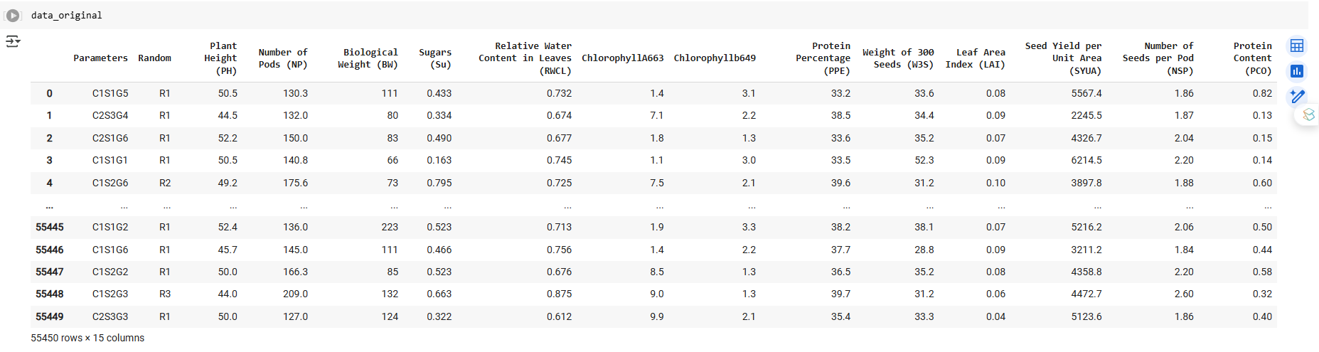
Introduction
Dataset Description
Consists of discrete categorical variables like – C, G and S
Also consists of continuous variables that impact the growth and yield of soyabean.
Notes:
“The dataset includes both categorical and continuous variables. Genotype (G), Salicylic acid level (S), and Water stress (C) are the primary categorical parameters. The rest are continuous traits that influence yield, like sugars, leaf area, and plant height.”

Slide 5
Introduction
Adopted Convention for data:
Input Parameters – Parameters measured before the crop is sown, i.e., parameters measured apriori – C, G and S parameters
Output Parameters – Parameters measured after the crop is harvested, i.e., parameters measured aposteriori
Target Parameters – The distinct growth levels obtained by clustering the data.
Notes:
“We classified the features into three categories: input parameters (C, G, S – measured before sowing), output parameters (measured post-harvest), and target parameters (growth labels obtained via clustering).”

Slide 6
Methodology
Data Preprocessing & Feature Engineering
Clustering Data to obtain distinct growth levels
Classification of clustered data
Insights, Results and more
Notes:
“Our approach consisted of four phases: preprocessing, clustering, classification, and final analysis. First, we cleaned and encoded the data, then applied clustering to determine yield groups, trained classifiers, and finally interpreted the results using SHAP and PDPs.”

Slide 7
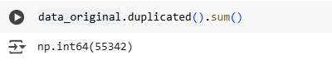
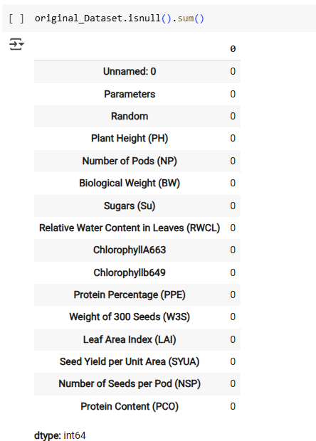
Data Preprocessing and Feature Engineering
The dataset does not have any NULL values, therefore did not require any preprocessing.
Interestingly, the dataset had 55,342 duplicate values which led to only 108 viable datapoints.
Notes:
“We discovered that the dataset had over 55,000 duplicates—after removing them, only 108 valid samples remained. We performed encoding for C, G, and S, removed redundant fields, and standardized the data to avoid feature bias. Various visualizations like pairplots, histograms, and correlation heatmaps were also used to understand data relationships.”

Slide 8
Data Preprocessing and Feature Engineering
The duplicate data was eliminated and further Exploratory Data Analysis was performed on this modified dataset
Ordinal Encoding and One-Hot Encoding of the ‘Parameters’ feature
The Parameters column consisting of 3 variables – C, G and S is further divided into separate feature for easy analysis.
This is performed using Ordinal Encoding of the Parameters Column, further One-Hot Encoding is also performed to eliminate any bias due to the classes.
Eliminating Redundant fields in the data – Fields such as Random and Parameters are removed once they are processed to reduce redundancy in the data.
Handling Outliers – Owing to a small number of datapoints (108), outliers were not handled.

Slide 9
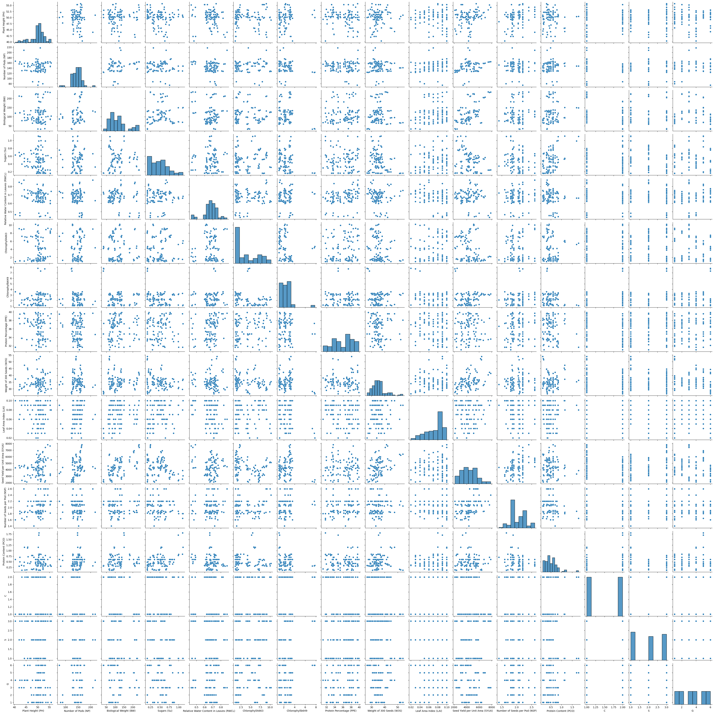
Data Preprocessing and Feature Engineering
Data was Standardized to remove any form of bias during the training of Algorithms.
The following graph shows the pairplot before standardizing the data.

Slide 10
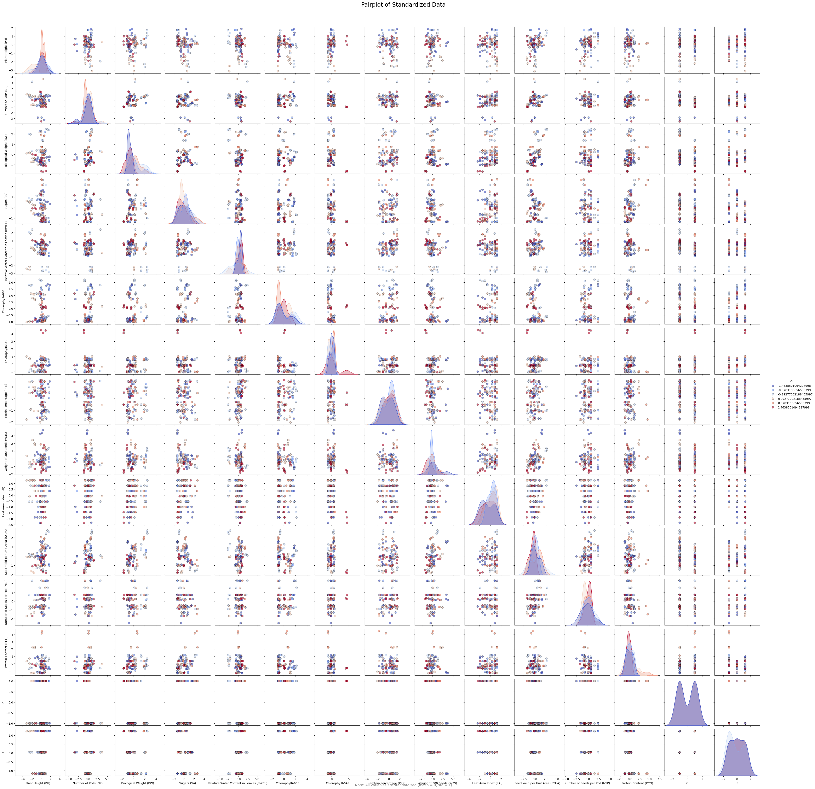
Data Preprocessing and Feature Engineering
Data was Standardized to remove any form of bias during the training of Algorithms.
The following graph shows the pair-plot after standardizing the data.

Slide 11
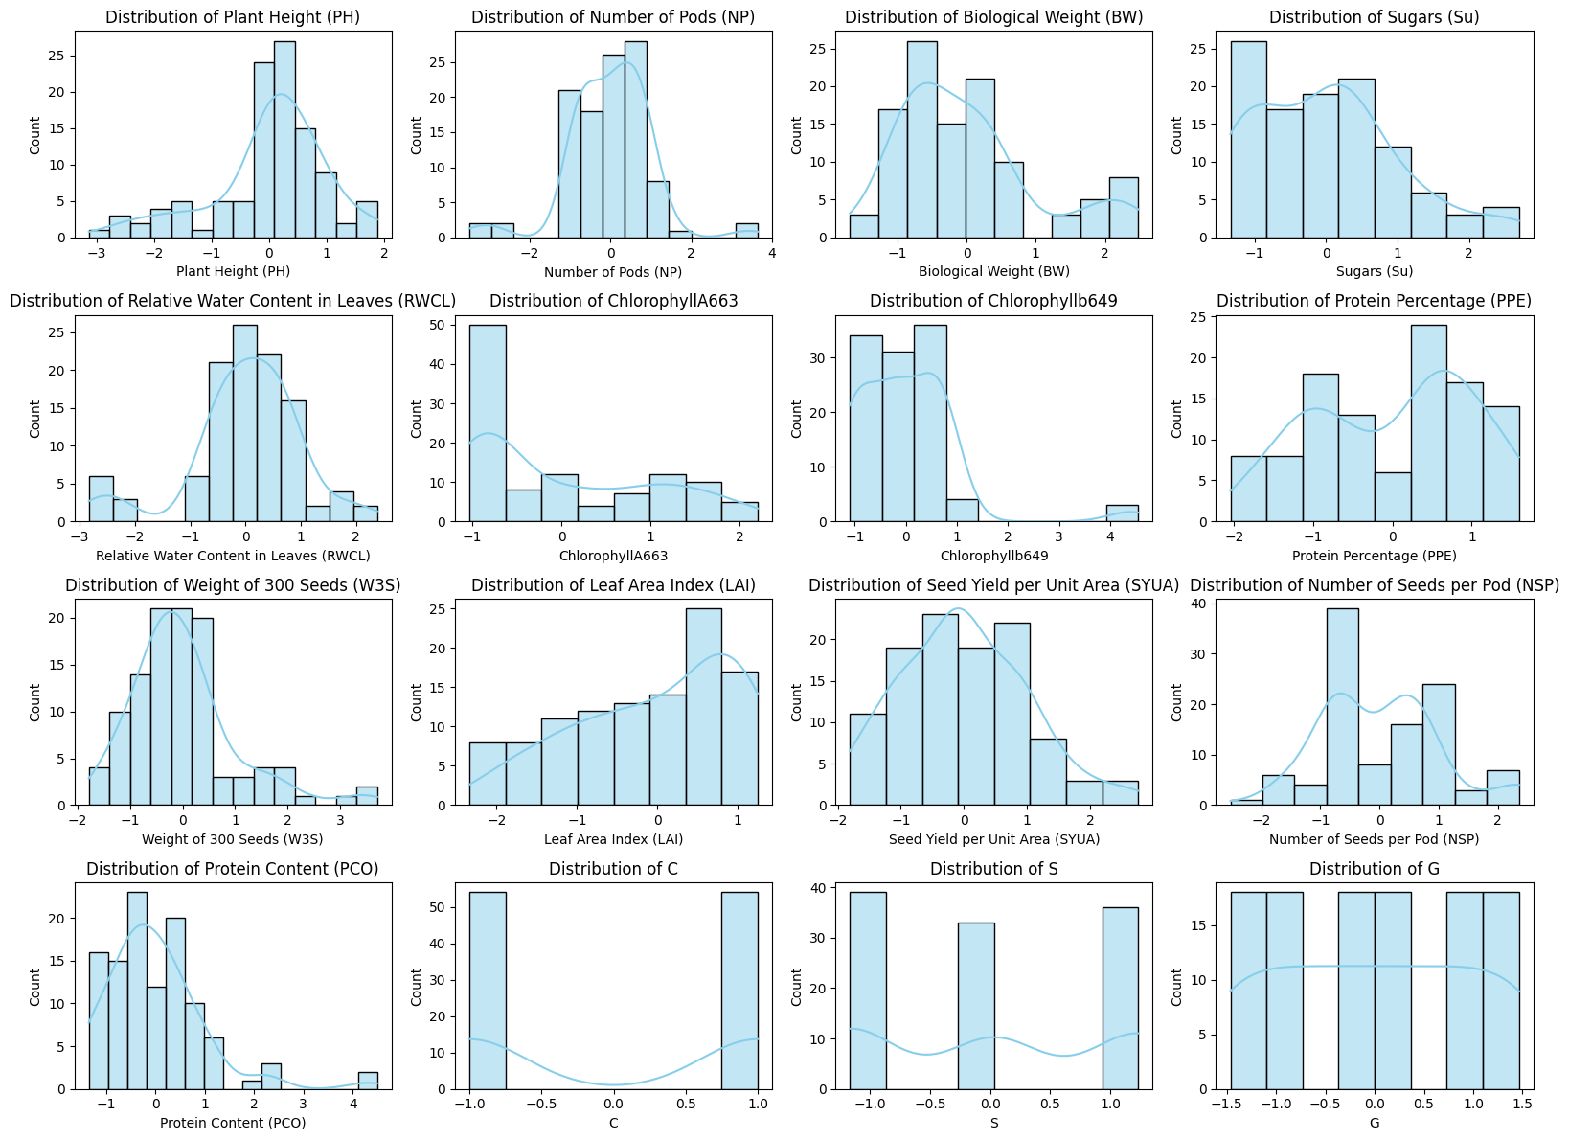
Data Preprocessing and Feature Engineering
Other Statistical Inferences
Distribution of all numerical attributes were plotted to analyse the data distribution.
We observed that most of them exhibit normal distributions upon standardizing.

Slide 12
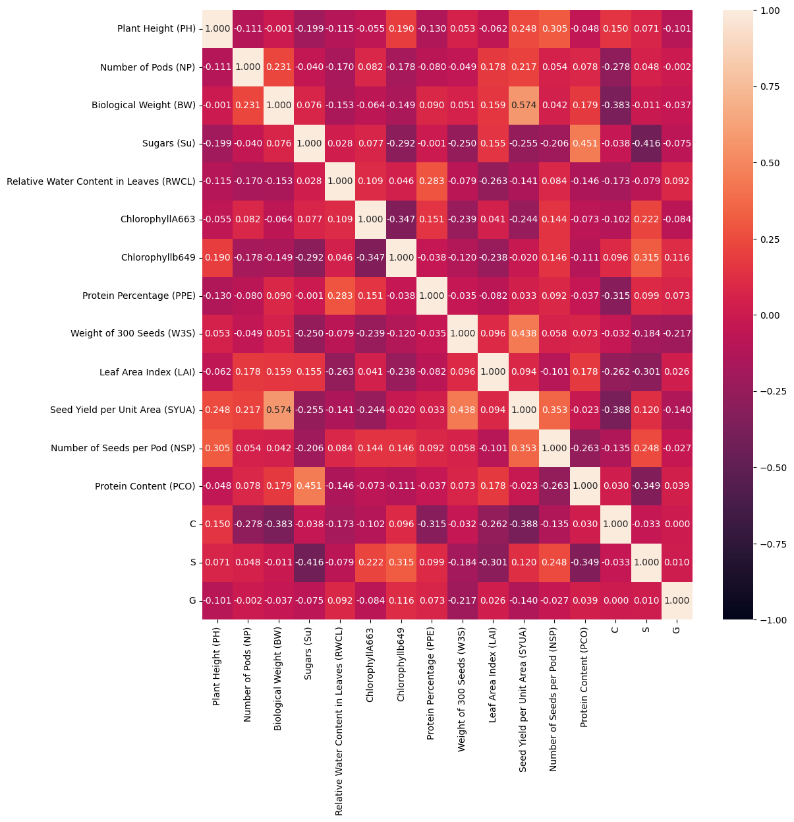
Data Preprocessing and Feature Engineering
Other Statistical Inferences
Correlation heatmaps were used to understand and analyse the influence of certain input and output parameters on the other parameters/variables in the dataset.

Slide 13
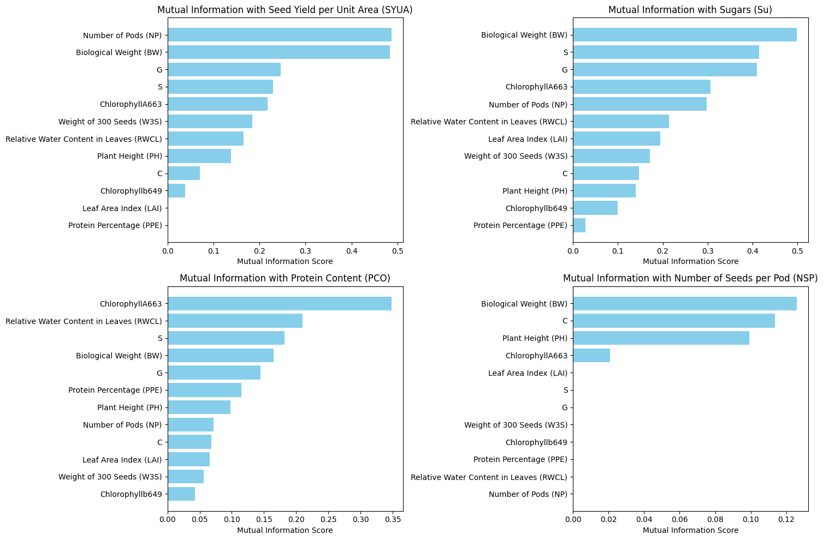
Data Preprocessing and Feature Engineering
Other Statistical Inferences
Certain parameters were presumed to be plausible parameters that could contribute to the overall yield.
Seed Yield per Unit Area (SYUA)
Sugars (Su)
Protein Content (PCO)
Number of Seeds per Pod (NSP)
Mutual Information Regression plots were made to understand and analyze the importance that these parameters had on the other parameters.

Slide 14
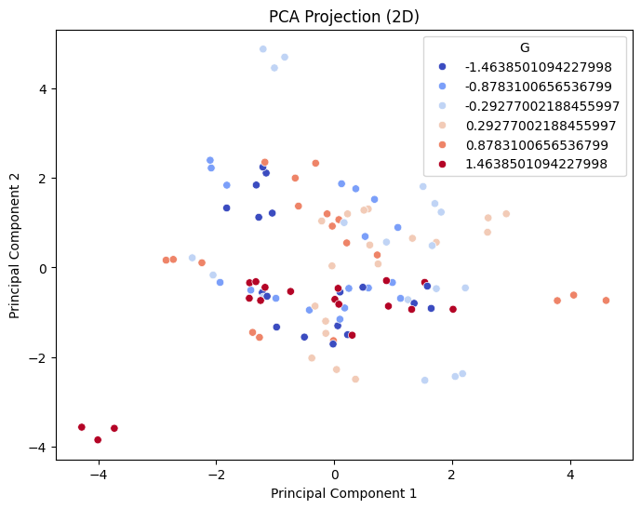
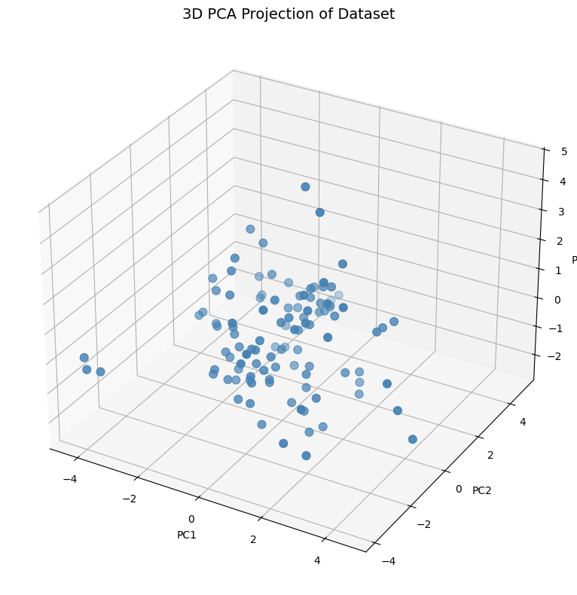
Data Preprocessing and Feature Engineering
Data Visualization

Slide 15
Clustering
Objective : To determine distinct growth levels by clustering data to determine optimal features for maximal yield.
Methodology: Clustering was performed in phases
Phase -1 : Clustering applied on all parameters
Phase -2 : Clustering applied on all output parameters
Phase -3 : Soft Clustering using Gaussian Mixture Model
Phase -4 : Clustering applied on select output parameters
Notes:
“We used clustering techniques like KMeans and KMedoids, selecting k=2 based on metrics like Silhouette Score, Davies-Bouldin, and Calinski-Harabasz. These helped us distinguish between good and poor production classes effectively.”

Slide 16
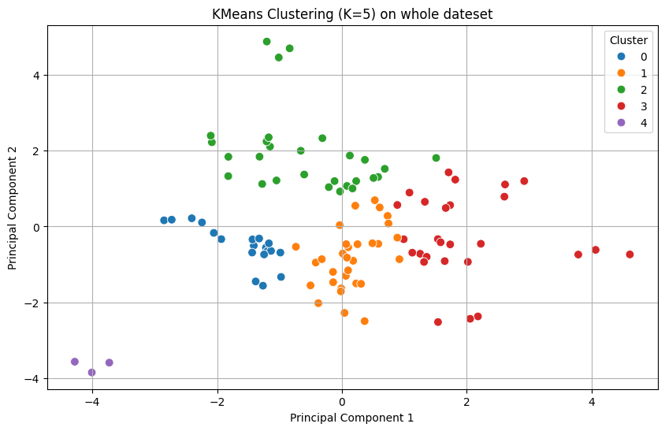
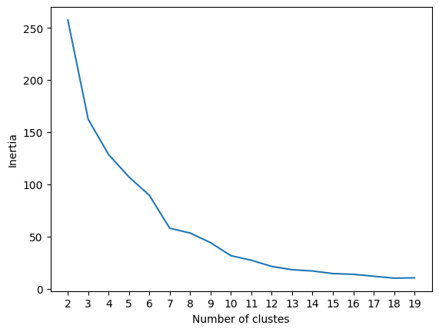
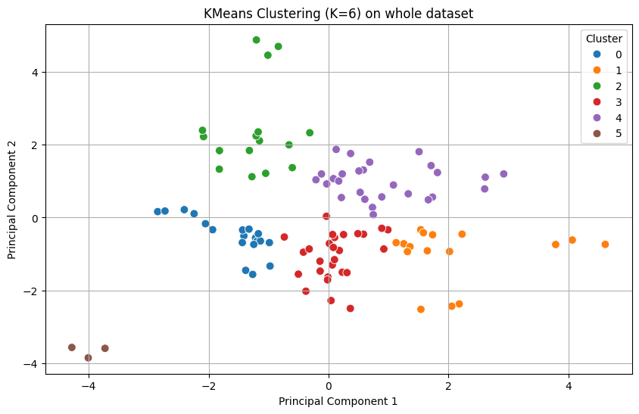
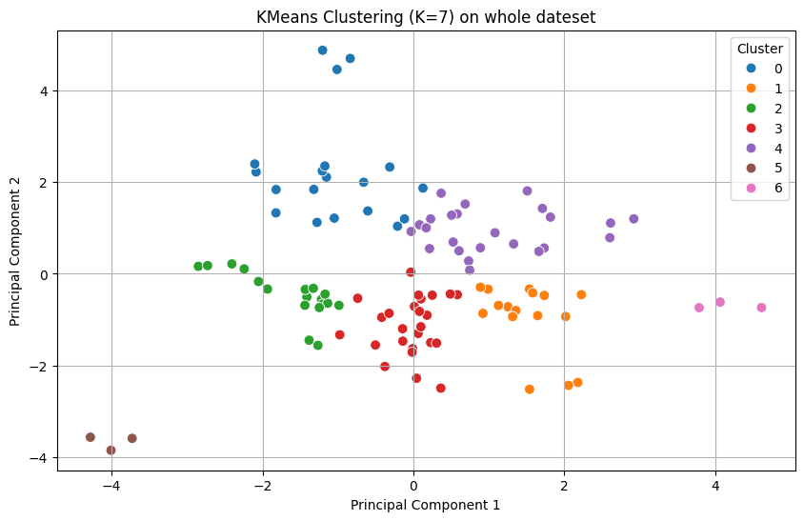
Clustering : Phase -1
Notes:
“Visualizations show clear separation between the clusters. This step allowed us to label the data for use in supervised classification.”

Slide 17
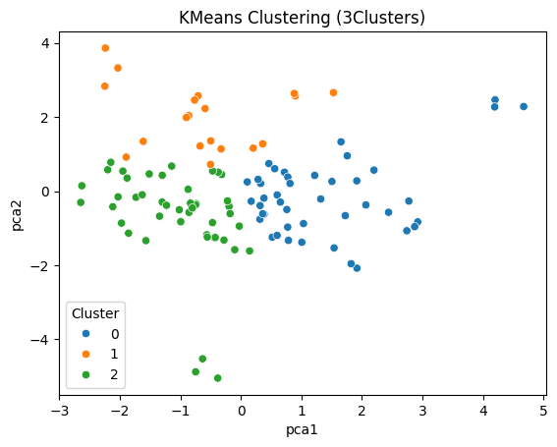
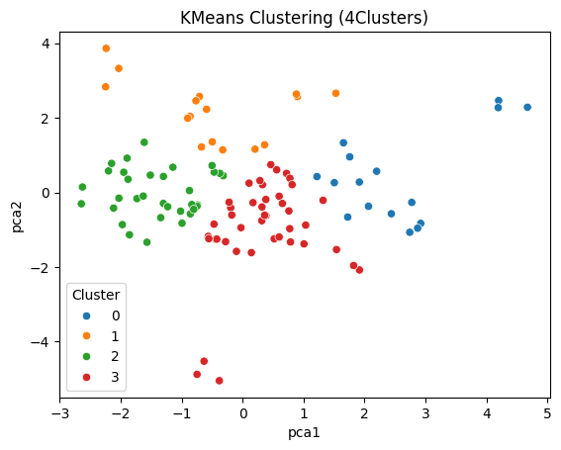
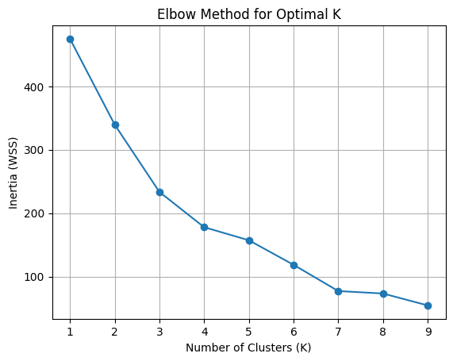
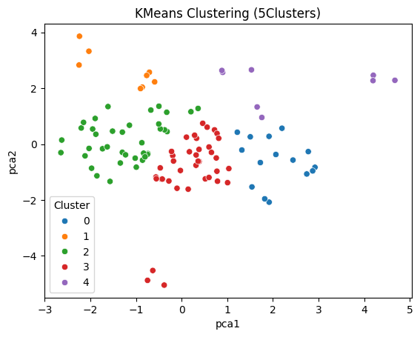
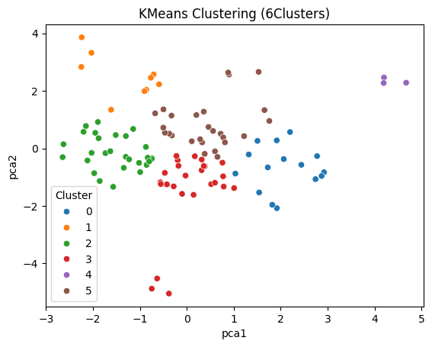
Clustering : Phase -2

Slide 18
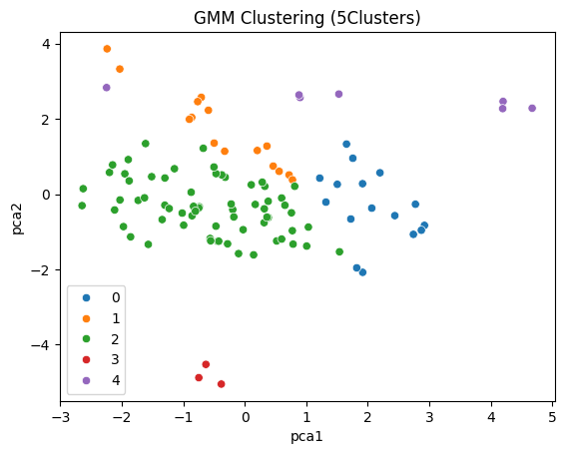
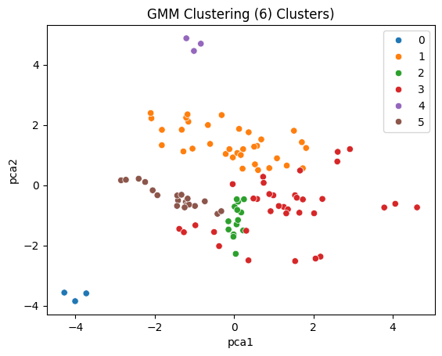
Clustering : Phase -3

Slide 19
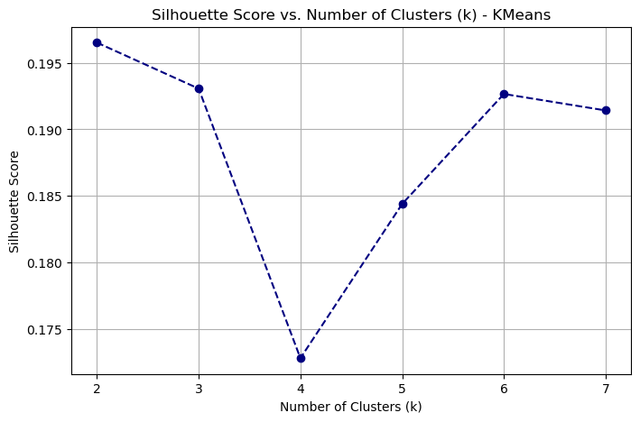
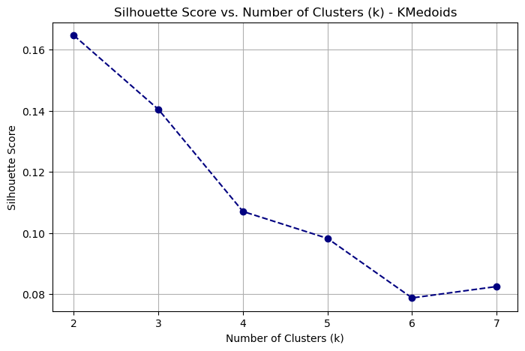
Clustering – Phase 4

Slide 20
Clustering - Evaluation
To determine the effectiveness of the clusters, the following evaluation metrics were used.
Silhouette Score
David Bouldin Score
Calinski Harabasz Score
Bayesian Information Score
Akaike Information Score

Slide 21
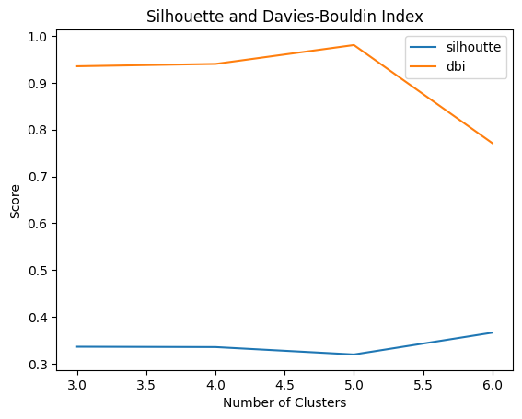
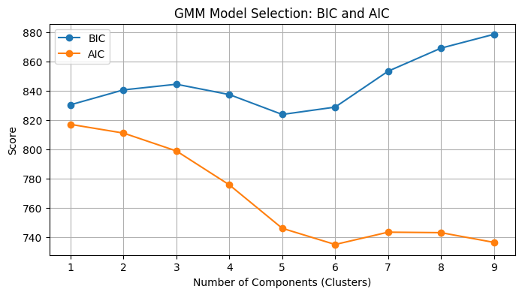
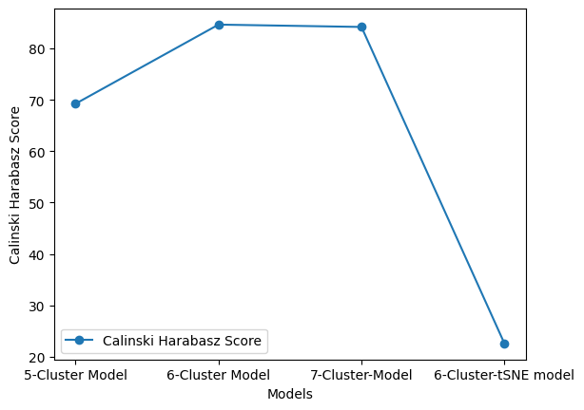
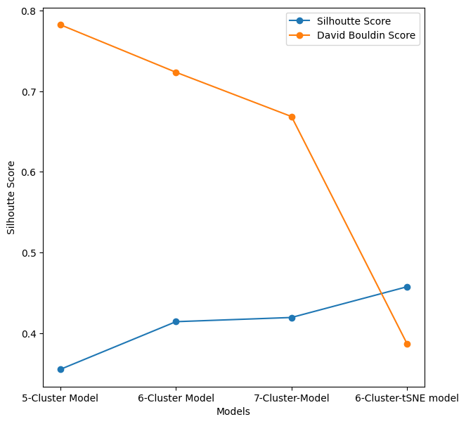
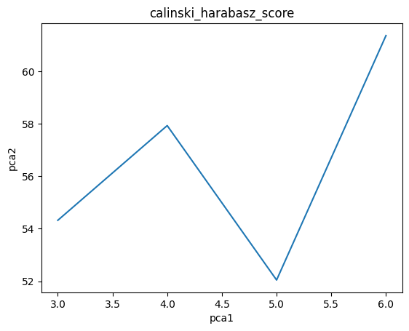
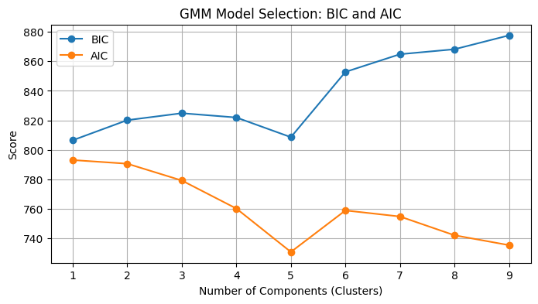
Clustering - Evaluation
Phase - 1
Phase -2
Phase -3

Slide 22
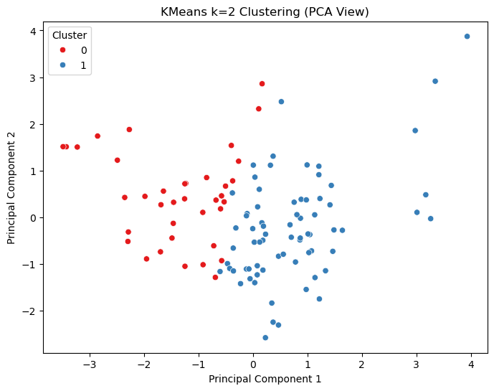
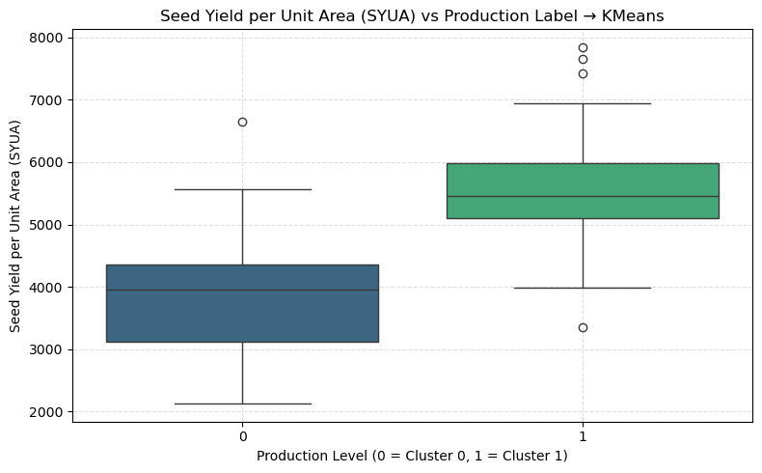
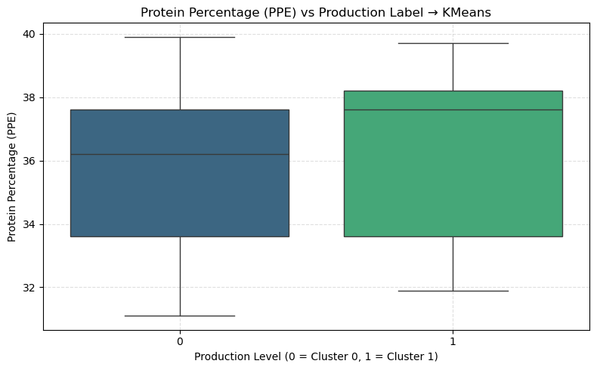
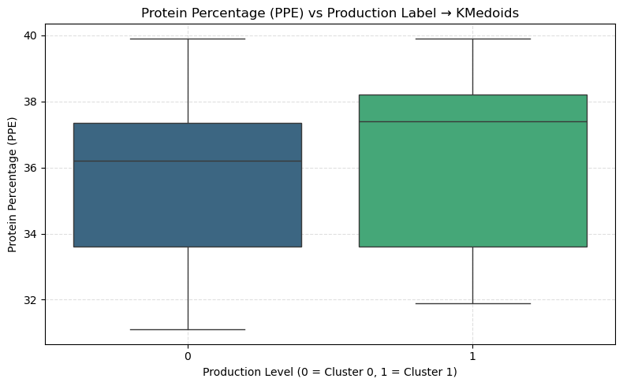
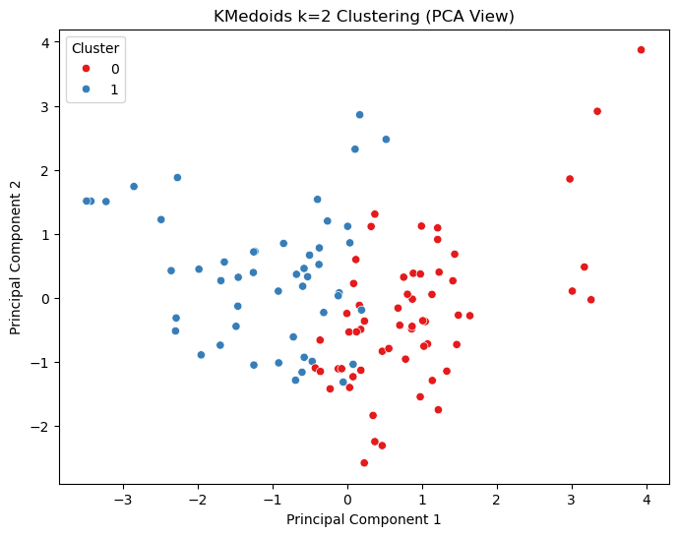
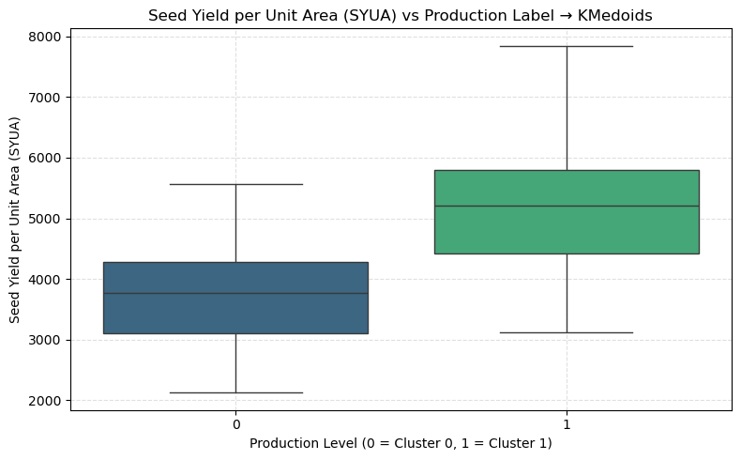
Clustering : Phase -4 - Evaluation

Slide 23
Clustering – Results
For clustering the soybean samples based on phenotype and genotype features, we selected k = 2 for both K-Means and K-Medoids due to the following reasons:
Interpretability: Boxplots of selected output parameters across clusters showed clear and meaningful separation between the two classes. This provided a biologically interpretable split into “high production” and “low production” categories.
Dataset Size: The dataset consisted of only 108 unique observations. Using more than 2 clusters would lead to fewer samples per cluster, making it impractical for downstream classification and analysis tasks.
Robustness: K-Medoids, being less sensitive to outliers compared to K-Means, was especially useful when dealing with real-world agricultural data where minor noise or measurement error is common.

Slide 24
Classification
Algorithms used
Random Forest Classifier
XGBoost
SVM
Neural Networks
Approach:
The Cluster results were used as target variables and were classified based on different sets of input data – CGS parameters, Output Parameters and All parameters.
Notes:
“We trained classifiers using input-only, output-only, and all parameters. Among various models tested, XGBoost on all features with KMeans clustering gave the best performance. We used GridSearchCV for hyperparameter tuning.”

Slide 25
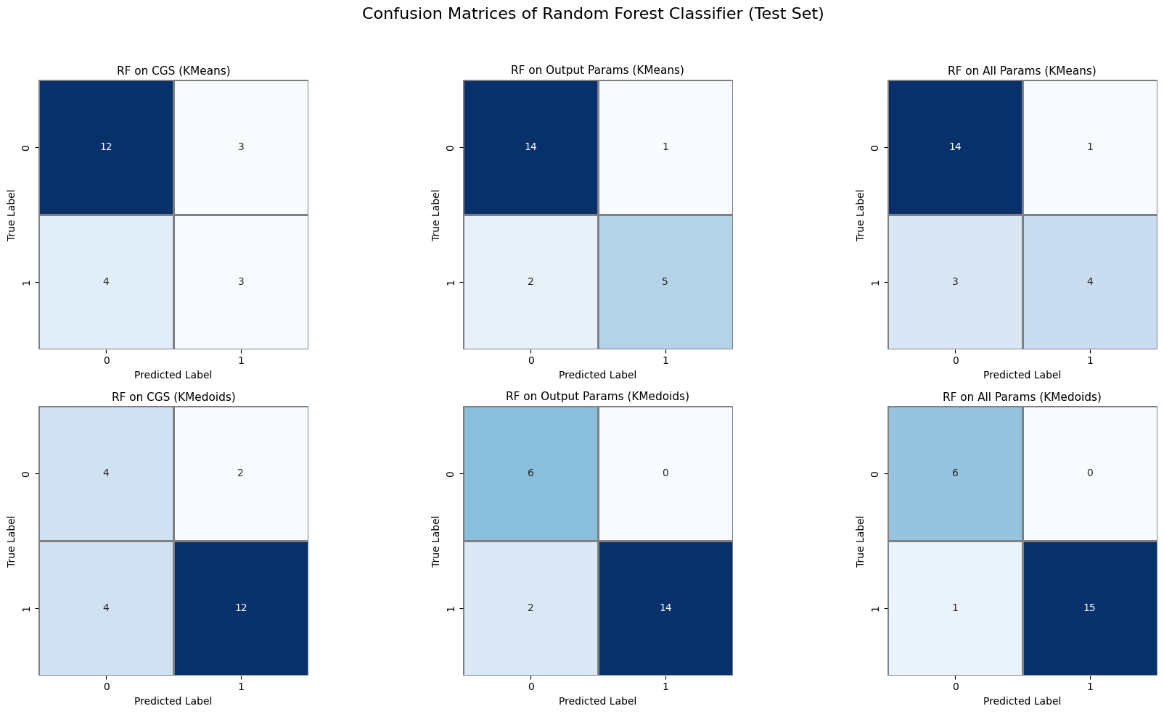
Classification – Random Forest
Best overall Performance from Random Forest Classifier on
all parameters in the Kmedoid(2) Dataset

Slide 26
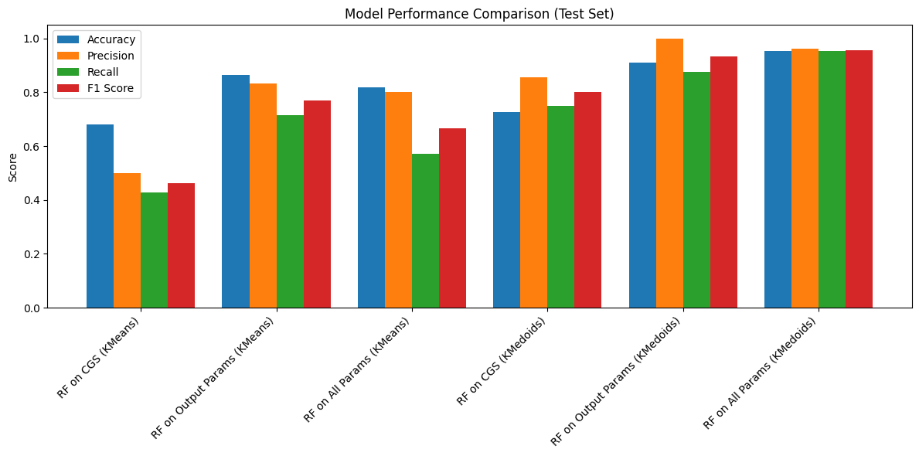
Classification – Random Forest
Best overall Performance from Random Forest Classifier on all parameters in the Kmedoid(2) Dataset

Slide 27
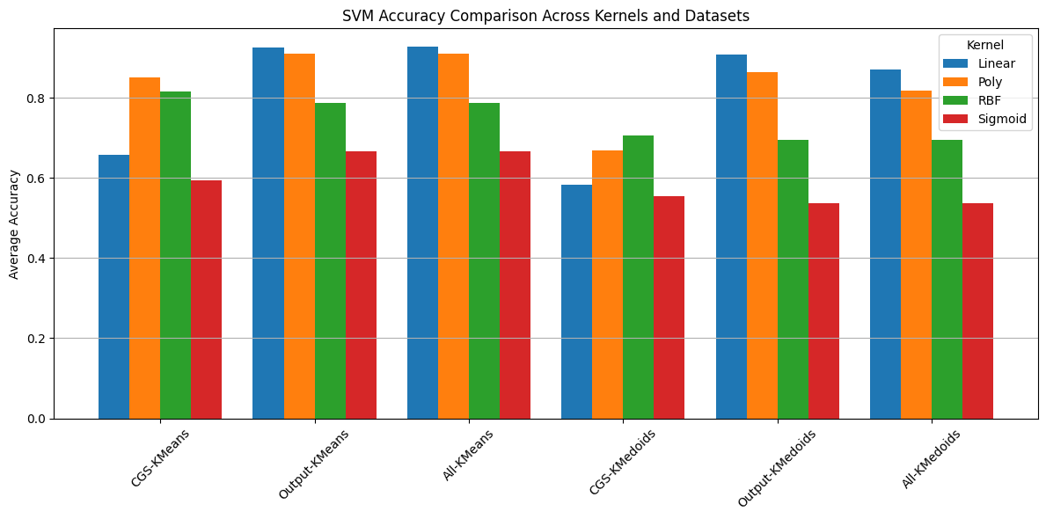
Classification – SVM
Best overall Performance from SVM Classifier on
all parameters in the KMeans(2) Dataset

Slide 28
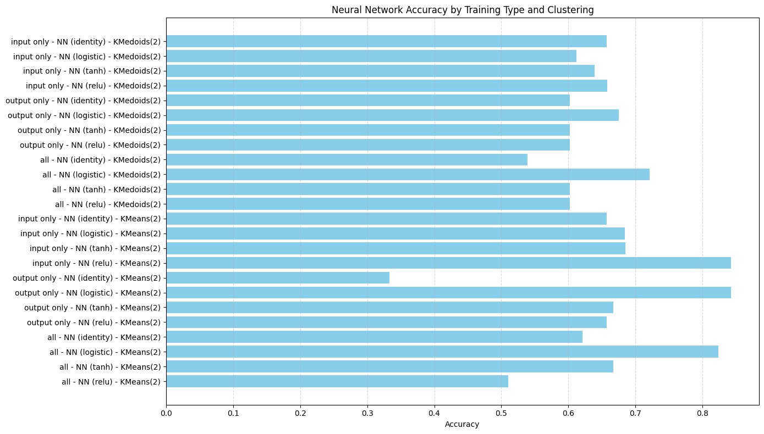
Classification – Neural Networks
Best overall Performance from Neural Networks Classifier on
input parameters in the KMeans(2) Dataset with
RELU and Logistic Activation functions

Slide 29
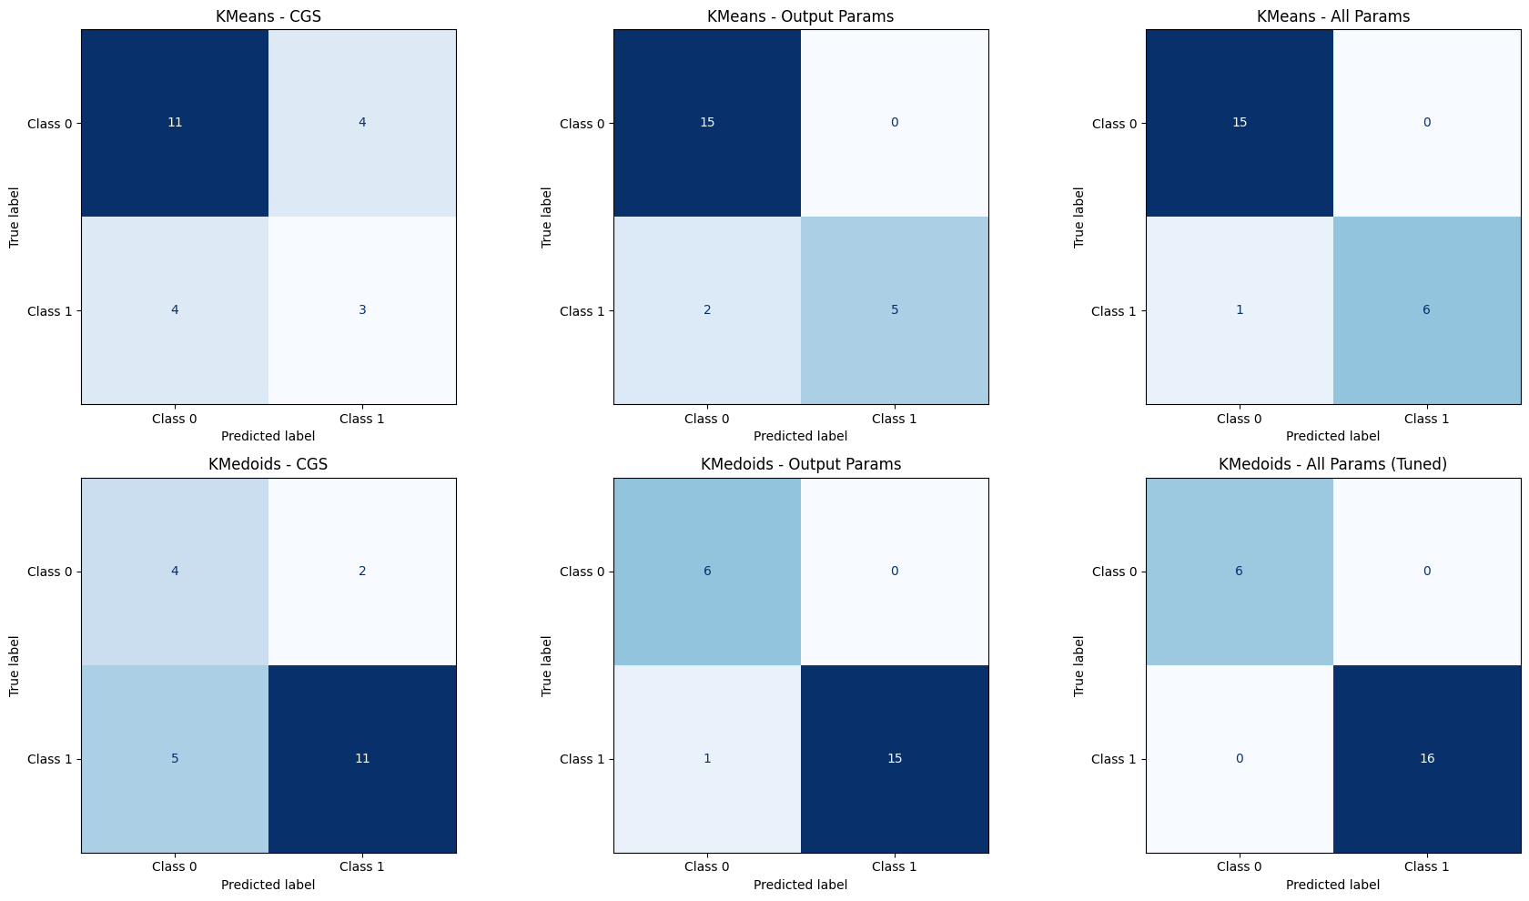
Classification – XGBoost
Best overall Performance from XGBoost Classifier on All parameters in the KMeans(2) Dataset

Slide 30
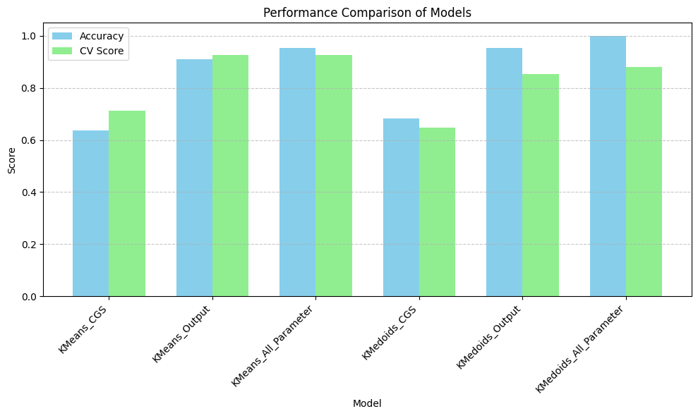
Classification – XGBoost
Best overall Performance from XGBoost Classifier on All parameters in the KMeans(2) Dataset

Slide 31
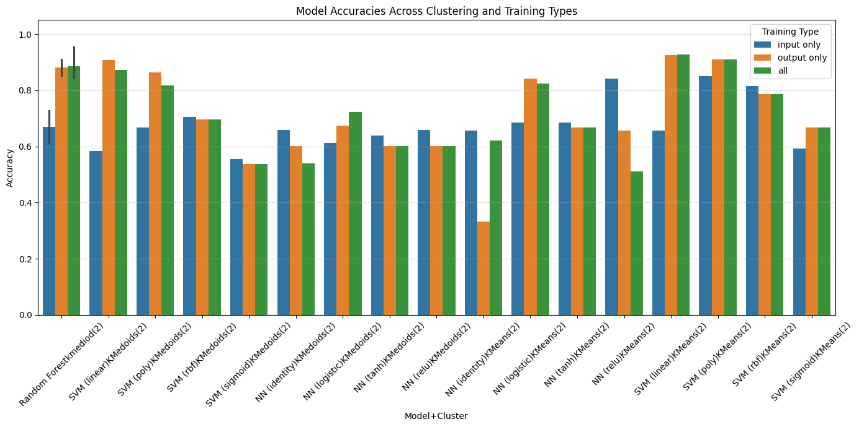
Classification – Results
Notes:
“Here’s a snapshot of our classification outcomes. The highest accuracy—95.45%—was achieved using XGBoost on all parameters with KMeans. Cross-validation showed good generalizability with a score of 92.64%.”

Slide 32
Classification – Results
Best Algorithm
XGBoost on Kmeans(2) Dataset with an accuracy of 0.9545 and a cross validation score of 0.9264
Similar results
XGBoost with all parameters on Kmedoid(2) dataset with a cross validation score of 0.8792
Random Forest with All parameters on Kmedoid(2) dataset with a cross validation score of 0.8792
Notes:
“XGBoost outperformed all models. Random Forest also showed strong performance. Neural Networks, however, underperformed due to the small dataset size. This highlights the importance of dataset quality and feature diversity.”

Slide 33
Classification – Results
Notable Results
K-means Clustering slightly edges out K-medoid Clustering in the top performing models.
Training on all parameters yielded the best results.
XGBoost with hyperparameter tuning yielded the best results
Neural Networks consistently had a low performance owing to a small dataset.

Slide 34
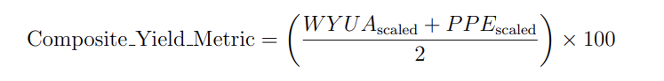
Composite Yield Metric
We used this metric to quantify soybean productivity while considering both yield and nutritional quality, we defined it as follows:
1. Compute Weighted Yield per Unit Area (WYUA):
WYUA = Weight of 300 Seeds (W3S) 300 × Seed Yield per Unit Area (SYUA)
2. Normalize WYUA and Protein Percentage (PPE) to [0, 1] using MinMaxScaler.
3. Compute the final composite score:
The Composite Metric provides a balanced view of both yield quantity and protein content.

Slide 35
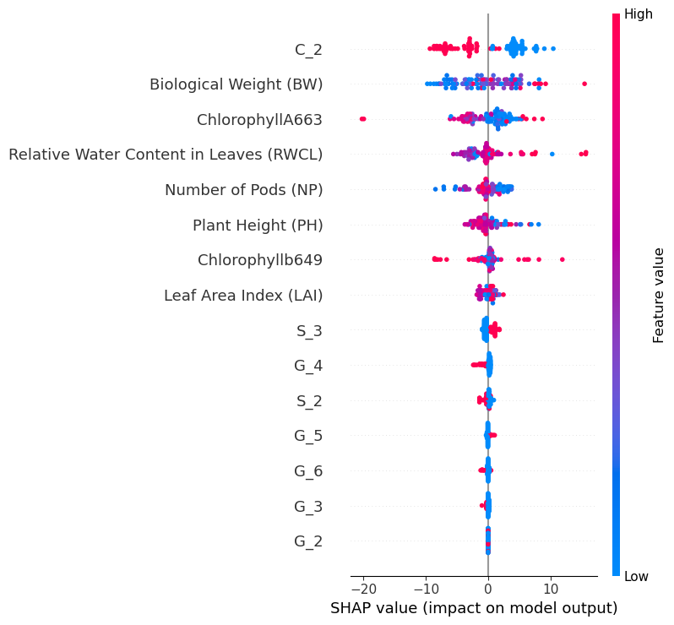
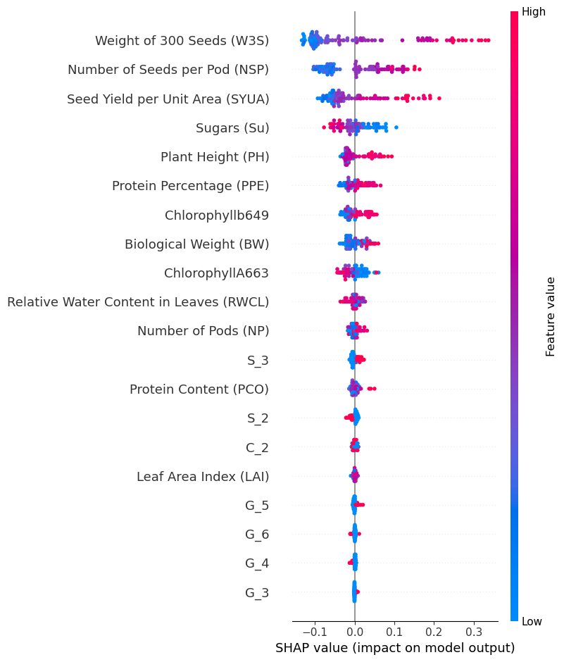
Analysis of optimal parameters
Original Dataset based on regression
Clustered dataset on K-means with select output parameters
Notes:
Using SHAP (SHapley Additive exPlanations), we visualized feature importance. On both the original regression-based dataset and the clustered dataset, features like Seed Yield per Unit Area, Protein Content, and Sugars had the most influence.”

Slide 36
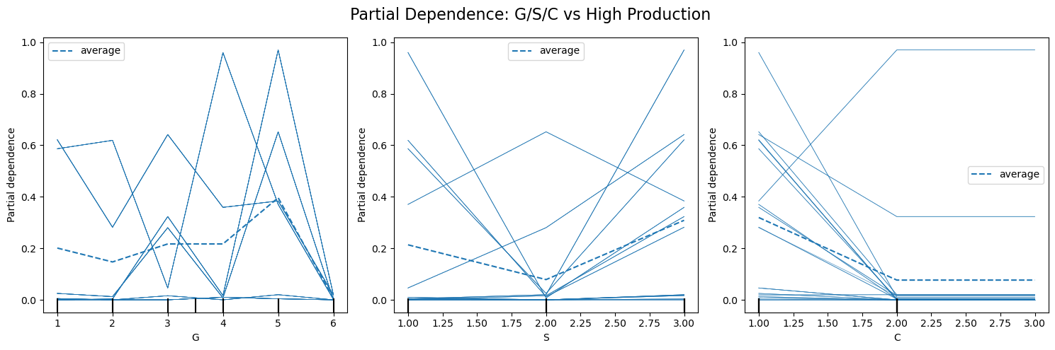
Analysis of optimal parameters
Notes:
“Partial Dependence Plots show how Genotype, Salicylic Acid level, and Water stress affect production probability. Genotypes G1 and G3, Salicylic acid at 250 mg, and moderate water stress were optimal for higher productivity.”

Slide 37
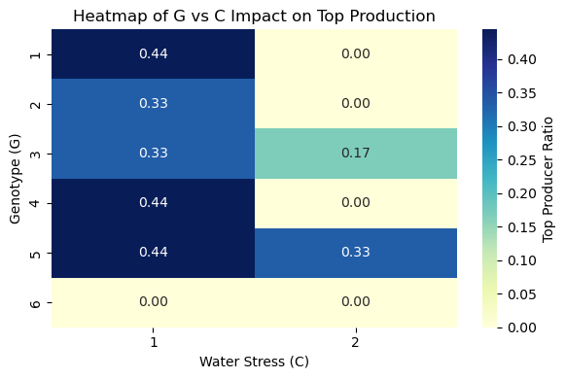
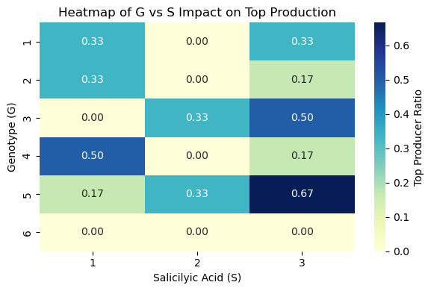
Analysis of optimal parameters
Heatmap Showing top performing Combinations of parameters
Notes:
These heatmaps show top-performing combinations of Genotype with C and S values. G1 and G3 consistently perform better under moderate water stress and 250 mg salicylic acid treatments.”

Slide 38
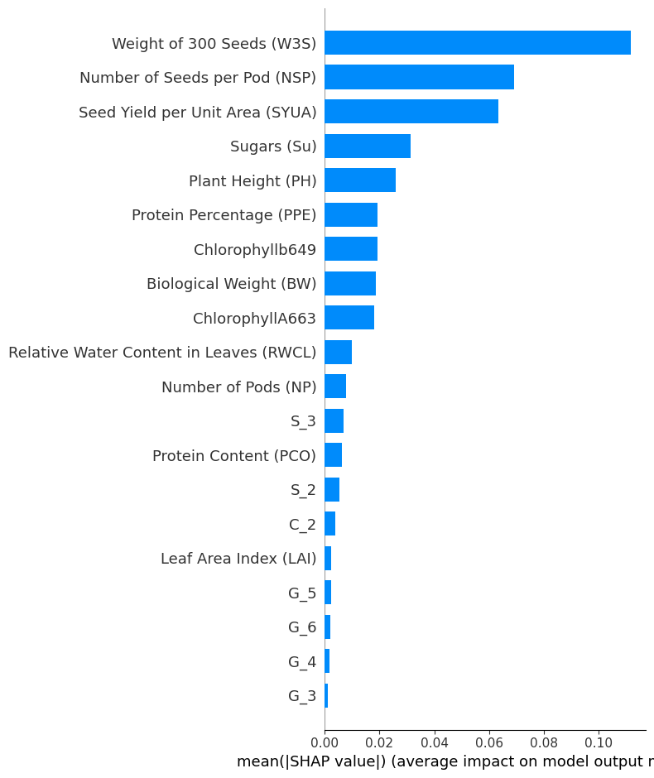
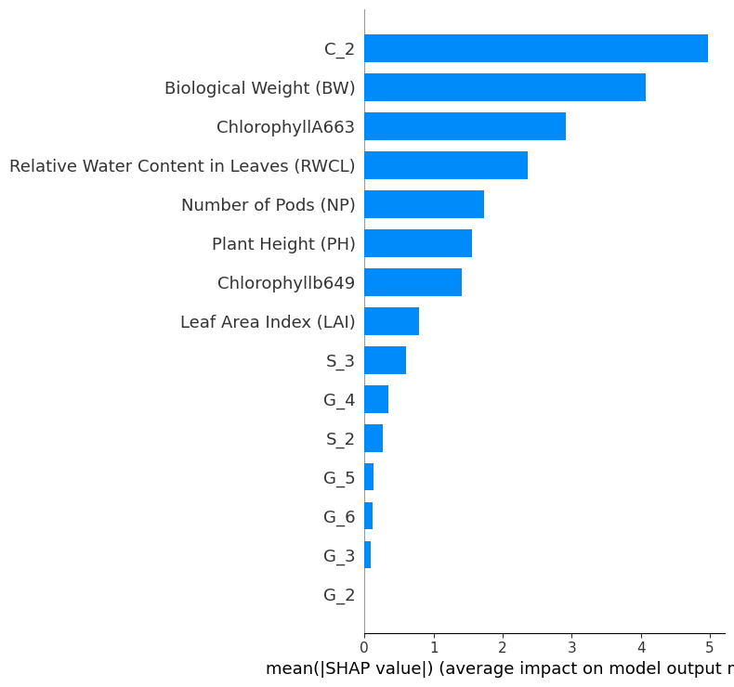
Analysis of optimal parameters
Notes:
“The bar plot representation reiterates the dot plot insight. Again, yield, protein content, and sugars dominate feature importance. This cross-validates our model’s decisions and helps build trust in the pipeline.”

Slide 39

Analysis of optimal parameters
Waterfall plot – Top performing sample
Notes:
“This waterfall plot shows how features contribute to a high prediction score for the best-performing sample. Each step adds or subtracts from the base value, giving an interpretable explanation of the prediction.”

Slide 40
Conclusion
SHAP analysis and Partial Dependence Plots emphasized the importance of Seed Yield per Unit Area, Protein Content,W3S, and Sugars in driving productivity.
Agronomic treatment factors such as Genotype G5/G1/G3, 250 mg Salicylic Acid, and moderate water stress (70% FC) were associated with optimal soybean performance
Notes:
“SHAP and PDP analysis helped us pinpoint the most influential features for soybean productivity: Seed Yield, Protein Content, Sugars, and W3S. The best treatment involved G1/G3 genotypes, 250 mg Salicylic Acid, and 70% Field Capacity water stress.”

Slide 41
Conclusion
Optimal Ranges Observed:
Biological Weight (BW): 80–90
Sugars (Su): 0.2–0.3 and 0.45–0.55
Plant Height (PH): 40–49 and 54–56
Chlorophyllb649: 1–3
Leaf Area Index (LAI): 0.02–0.05 and 0.075–0.10
Seed Weight: Higher weights positively influenced the Composite-Metric.
Number of Pods and Seeds: More pods per plant resulted in improved outcomes.

Slide 42




Conclusion

Slide 43
Future Scope
Temporal Analysis of time series data to better observe the impact and effect of growth variables on the yield over time.
Precision Agriculture integration by combining the classification framework with drone or satellite for real time decision support systems.
Transfer learning methods to adapt the trained models to other crops without retraining from scratch.
Notes:
“Future directions include time-series modeling for temporal insights, integration with drone/satellite imagery for real-time precision agriculture, and using transfer learning to apply our model to other crops.”

Slide 44
Thank you
Notes:
“Thank you for your attention! We’re happy to answer any questions.”

